Slide 1
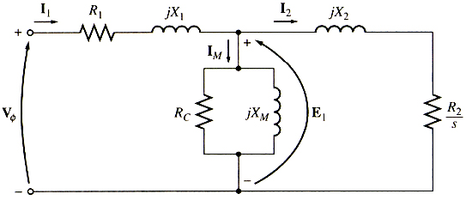
Induction Machines
Core (Iron) Loss
The core losses including the eddy current loss and hysteresis loss can be included in the equivalent circuit exactly in the same manner as in transformers.
Since an induction motor normally operates at a speed near synchronous speed, the relative motion of the magnetic fields over the rotor surface is quite slow, and the rotor core losses are very tiny compared to the stator core losses and can be neglected.

Slide 2
Induction Machines
The power flow diagram
P_{ag} = T_{i} ω_{s}
P_{dev} = T_{dev} ω_{m}
P_{out} = T_{out} ω_{m}
P_{in} =Real(3 V₁ I₁*)
Mechanical
Losses
Stray losses
Stator copper loss
3 I₁² R₁
Rotor copper loss
3 I₂ ² R₂
Core losses
P_{rot} = P_{mech}+ P_{stray}
P_{dev} = 3 I₂² R₂ (1- s) / s
P_{out} = P_{dev} - P_{rot}
P_{ag} = 3 I₂² (R₂ / s)

Slide 3
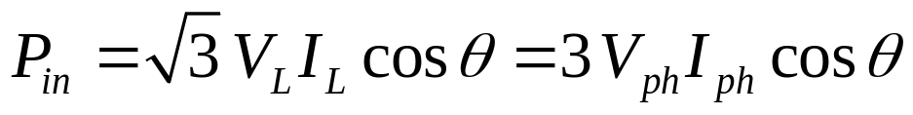
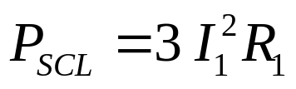
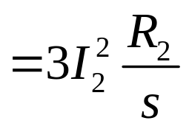
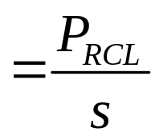
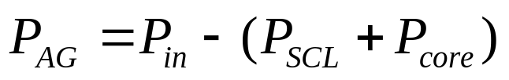
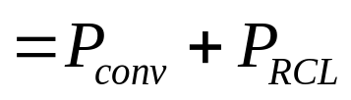
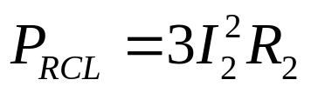
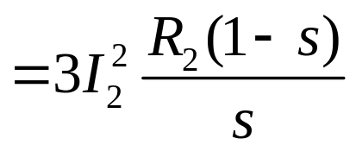
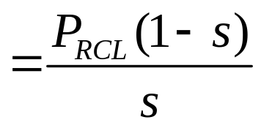
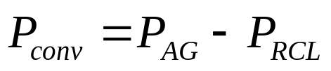
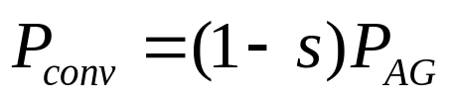
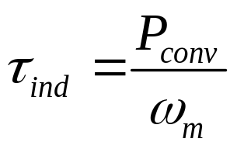
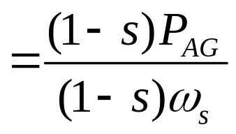
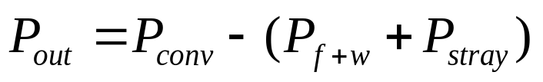

Induction Machines
The efficiency

Slide 4
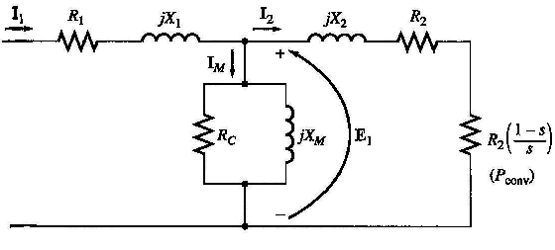
Induction Machines
Determining Circuit Model Parameters
There are basically 3 types of tests that can be done on an Induction motor:
  DC test
  No-load test
  Locked Rotor test or Blocked Rotor test

Slide 5
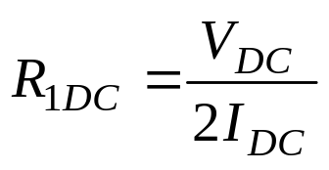
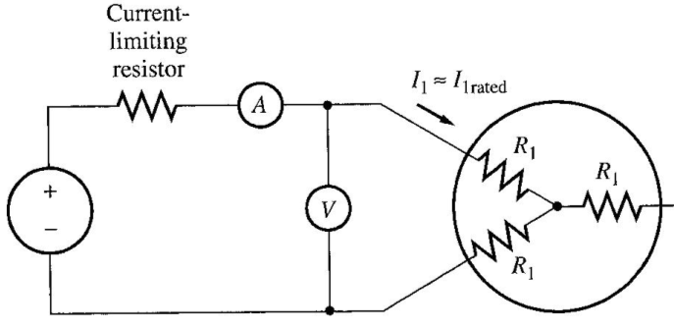
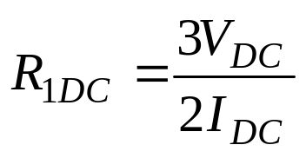
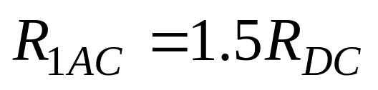
Induction Machines
DC test
DC voltage is applied across the motor terminal and current flow is adjusted to rated condition . Voltage and current flow is noted. If the stator is Y-connected, the per phase stator resistance is:
If the stator is delta-connected, the per phase stator resistance is:
This method is not accurate since the skin effects are neglected. The following empirical rule may be used as an approximation.

Slide 6
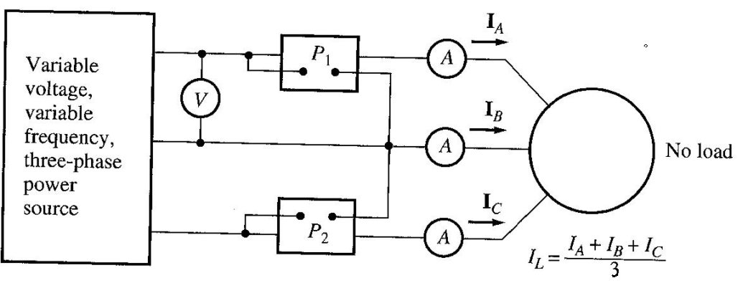
Induction Machines
The No-Load Test
The no-load test measures the rotational losses and provides info about its magnetization current.
The motor is allowed to spin freely
Rated AC voltage at nominal frequency is applied across the stator terminals.
Measure voltage, current and power flow.

Slide 7
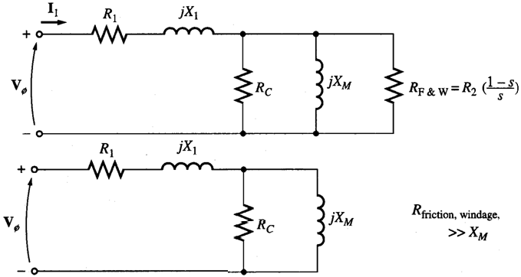
Induction Machines
The No-Load Test
The rotor will be rotating at near synchronous speed hence slip is very small. The no load test circuit and induction motor equivalent circuit is shown below:

Slide 8

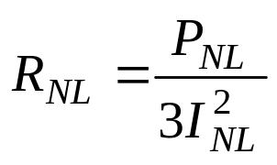
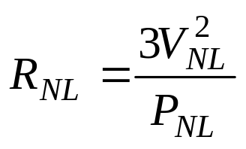
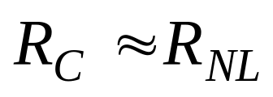
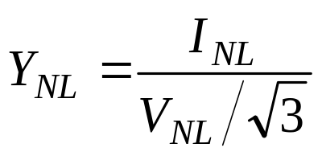
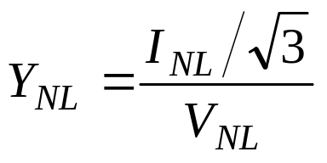
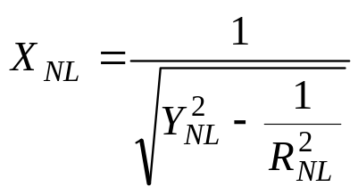

Induction Machines
The No-Load Test
For Y connection:
For Δ connection:
For Y connection:
For Δ connection:

Slide 9
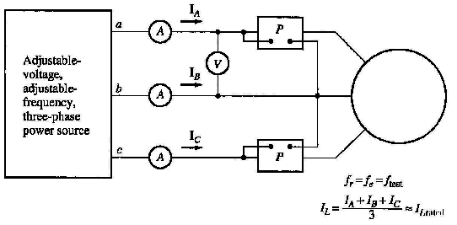
Induction Machines
The locked-rotor Test
The rotor is locked.
AC voltage is applied across the stator terminals and current flow is adjusted to full load condition.
Measure voltage, current and power flow.

Slide 10
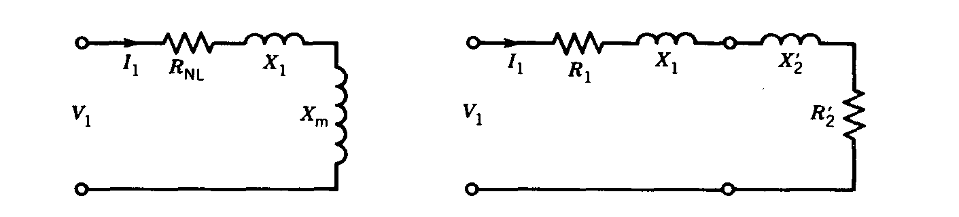
Induction Machines
The locked-rotor Test
Since the rotor is locked, slip would be at a maximum. Hence bulk of the current will flow through the rotor circuit rather than the magnetizing branch. Therefore the overall circuit is reduced to:

Slide 11

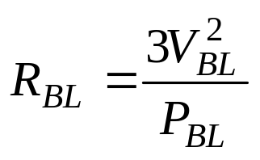

Induction Machines
The locked-rotor Test
For Y connection:
For Δ connection:
R1 may be found from the DC test, therefore we can calculate R’₂.
This test is generally inaccurate due to the fact that in real operation, slip would vary from starting and as the rotor approaches operating speeds. Frequency would affect the rotor reactance. This test may be done with a lower supply frequency (25% or less) to simulate small slip during operation.

Slide 12
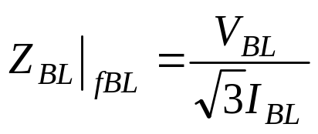
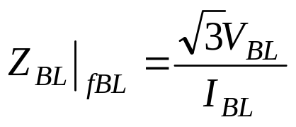
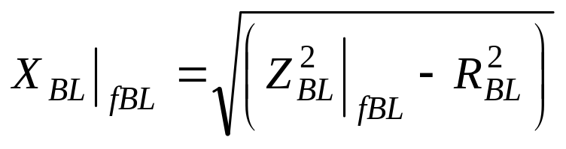
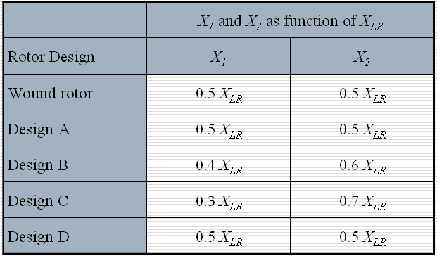
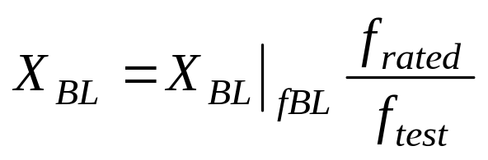
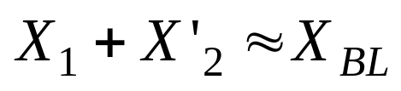
Induction Machines
The locked-rotor Test
For Y connection:
For Δ connection:

